Slide 1
Page load optimization

Slide 4
Page load optimization

Slide 5
Lesson 1: Page load optimization
The Page Diagnostic tool for SharePoint.
Choosing the “right tool.”
Network optimization
CDN
Navigation
Browsers
Modernization Scanner

Slide 6
Minimize calls to the service (SQL Query/Hits)
Most important thing to remember.
This primarily goes for landing pages:
Cold Load: first load of page, no browser caching
Warm Load: subsequent refresh, with content available in browser cache
Notes:
The name of the game is to bring down SQL calls to the service.
What is important to remember when we are testing is the differences between Cold loading a page and Warm loading a page and mark down the metrics.
Cold load is a fresh instance of a user loading a page that has no browser caching. When this happens, there typically will be a bit more delay (depending on the resources on the page) and will generally need to make more calls to the service
Warm load would be considering the second load of the page once the items on the page are cached so you will see less calls to the service and could see increased speed.

Slide 7
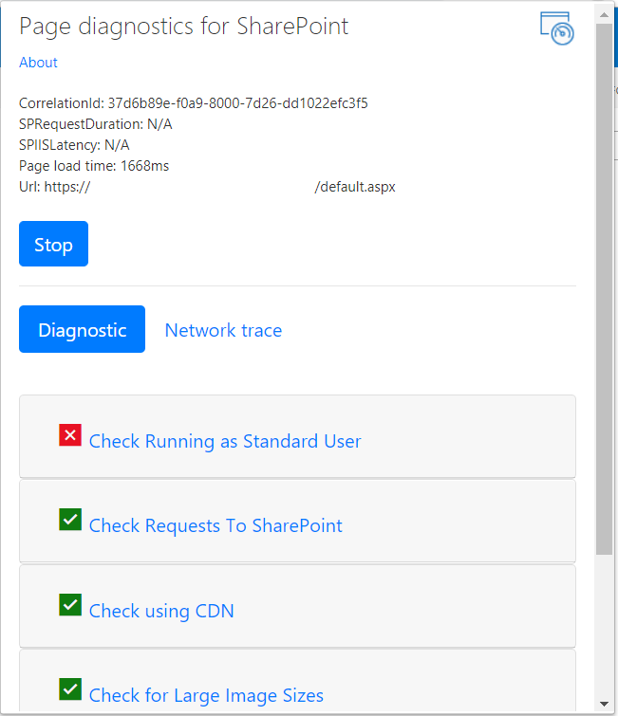
SharePoint Page Diagnostics tool (recap)
Official Microsoft tool to diagnose and troubleshoot page performance issues for:
Developers of customization: to check best practices.
Power Users: to report issues.
Admins: to narrow down issues.
Notes:
The tool is publicly documented at : https://support.office.com/en-us/article/use-the-page-diagnostics-tool-for-sharepoint-online-dbab2593-dc6a-40f7-adfe-031b9baa620f?ui=en-US&rs=en-US&ad=US

Slide 8
Office 365 Front Door
The O365 version of Azure Front Door.
Worldwide network of servers and software.
Microsoft leased or owned facilities:
Content delivery network (CDN) servers.
Dynamic Compute Servers.
Traffic Management appliances.
Microsoft shared services (Active Directory Domain Services (AD DS)).
Domain Name System (DNS).
Domain-Specific Language (DSL).
Etc.
Notes:
https://news.microsoft.com/europe/2017/09/22/a-cable-stretching-4000-miles-between-the-us-and-spain-is-the-key-to-a-high-speed-future/

Slide 9
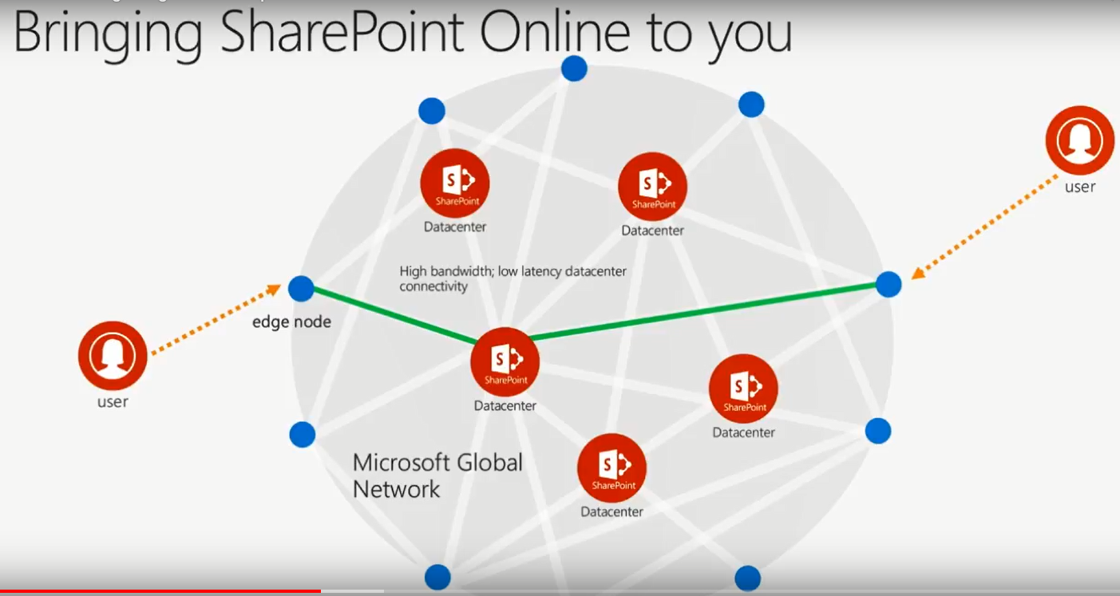
Office 365 Front Door: Concept

Slide 10
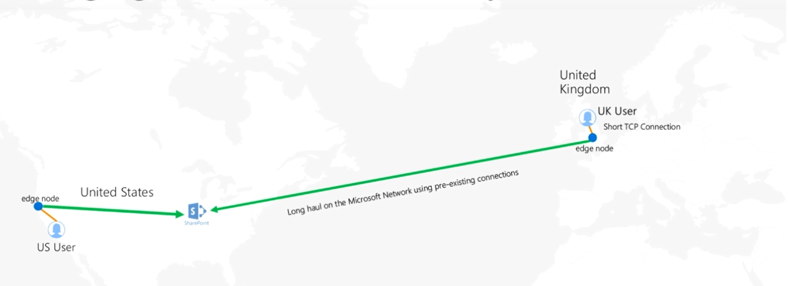
Office 365 Front Door: Concept (cont.)

Slide 11
Azure Front Door: Implementation concepts
Reuse warm TCP connection.
Reuse existing SSL connection.
Saving on SSL is even more significant than non-SSL.
7 handshakes vs. 4 handshakes.
Split TCP:
Azure Front Door is close to customer.
Long distance connection between AFD and App Server.
Chatty TCP connections perform proportional to RTT.
Notes:
More details on Azure Front Door:
https://docs.microsoft.com/en-us/azure/frontdoor/front-door-overview
https://channel9.msdn.com/Events/Ignite/Microsoft-Ignite-Orlando-2017/BRK1005

Slide 12
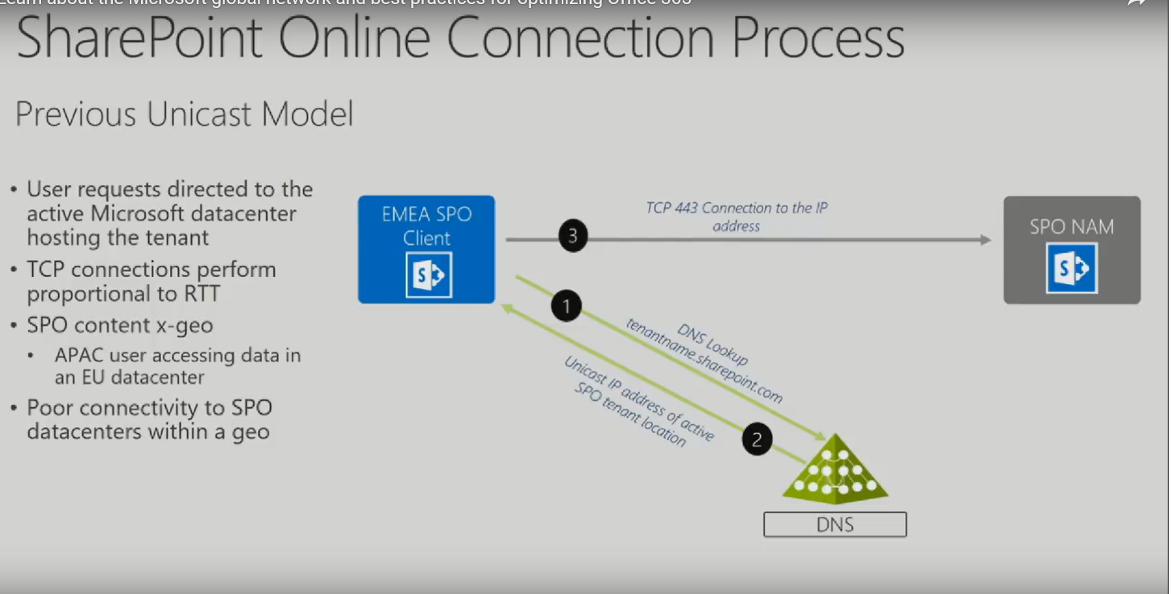
Azure Front Door: Implementation concepts (cont.)
Notes:
Optional slide
https://channel9.msdn.com/Events/Ignite/Microsoft-Ignite-Orlando-2017/BRK1005

Slide 13
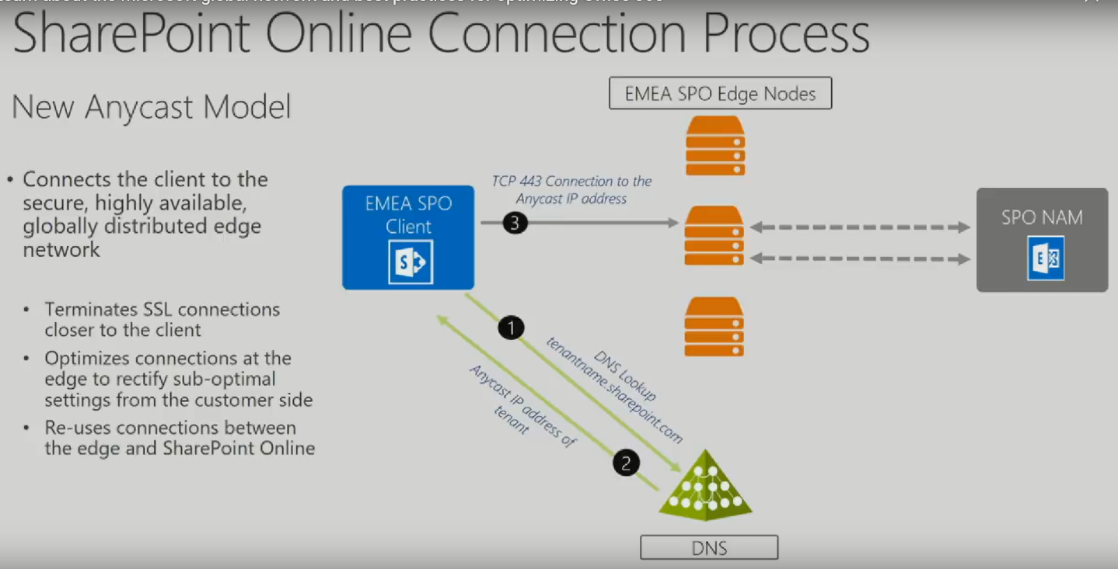
Azure Front Door: Implementation concepts (cont.)
Notes:
Optional slide
https://channel9.msdn.com/Events/Ignite/Microsoft-Ignite-Orlando-2017/BRK1005

Slide 14

Azure Front Door: Implementation concepts (cont.)
Total Response Time
TTFB
ack
TCP connect
Client RTT
ack
First Byte
GET
syn,ack
syn
ack
EDGE
Node
SSL connect
ack
syn,ack
Download Time
GET
ack
Server RTT
ack
App Latency
Response

Slide 15
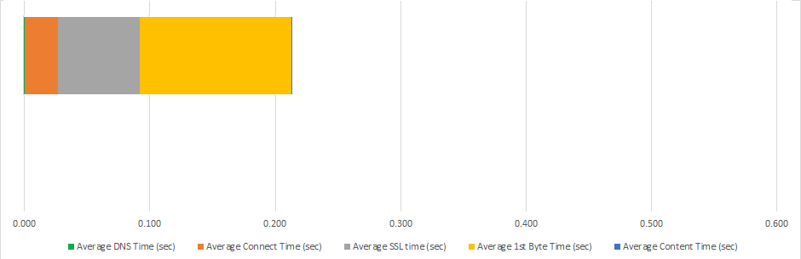
Azure Front Door: Implementation concepts (cont.)
Box Request without O365 AFD
Box Request with O365 AFD
0.545 sec/req
Connect Time = 0.105 sec
SSL Time = 0.329 sec
First Byte = 0.111 sec
0.202 sec/req
Connect Time = 0.026 sec
SSL Time = 0.065 sec
First Byte = 0.111 sec

Slide 16
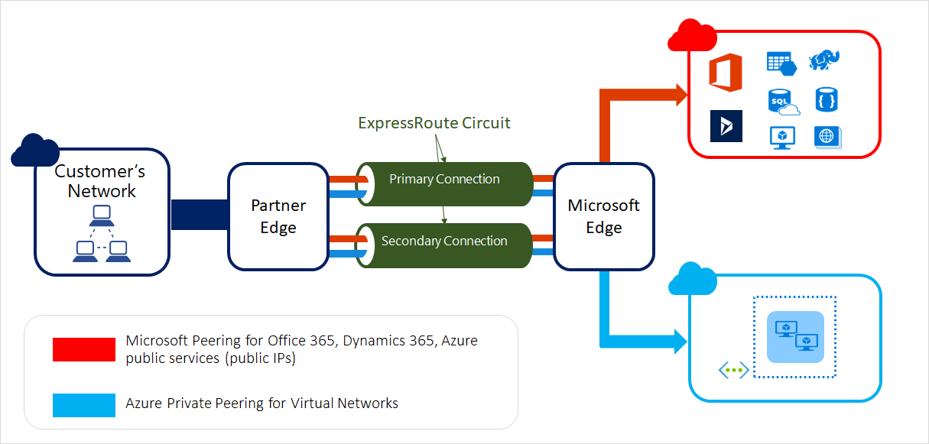
Express Route: Concept
Extend your on-premises networks into the Microsoft cloud over a private connection facilitated by a connectivity provider.
Notes:
Optional Slide
https://docs.microsoft.com/en-us/azure/expressroute/expressroute-introduction

Slide 17
Express Route: When to recommend?
DO
Infrastructure and platform services running in Azure benefit by:
addressing network architecture
performance considerations
DON’T
Software as a Service offerings (like Office 365):
have been built to be accessed securely and reliably via the Internet.
Notes:
https://docs.microsoft.com/fr-fr/office365/enterprise/azure-expressroute
Express Route is not a good idea in general for O365 scenarios. It can complexify many scenarios, with limited added value.
See https://docs.microsoft.com/fr-fr/azure/expressroute/expressroute-faqs for more on ExpressRoute for Office 365

Slide 18
CDN: Content Delivery Network
Static files are pushed to Akamai.
Benefits:
Geography: files cached closer to end users.
CDN domain supports the HTTP/2 protocol which provides parallel downloading.
CDN files are retrieved faster (flat files repository) than from SharePoint (SQL database).
Notes:
https://docs.microsoft.com/en-us/office365/enterprise/use-office-365-cdn-with-spo
https://www.youtube.com/channel/UC_mKdhw-V6CeCM7gTo_Iy7w/search?query=cdn

Slide 19
CDN: Private vs. Public vs. Public Common
O365 uses 2 types of CDN:
Public CDN
Private CDN
Static CDNs are available, for example: Ajax AspNetCDN.
Should be accessed directly.
Add them as bypass proxy exceptions.
Ex.: <script src=http://ajax.aspnetcdn.com/ajax/jquery-2.1.1.js />
Notes:
https://docs.microsoft.com/en-us/office365/enterprise/use-office-365-cdn-with-spo
https://www.youtube.com/channel/UC_mKdhw-V6CeCM7gTo_Iy7w/search?query=cdn
https://www.youtube.com/watch?v=DtnpVf1m7N4 – Why and How to Use CDNs
https://www.youtube.com/watch?v=gcVP8dbsjdM – Implementing CDNs

Slide 20
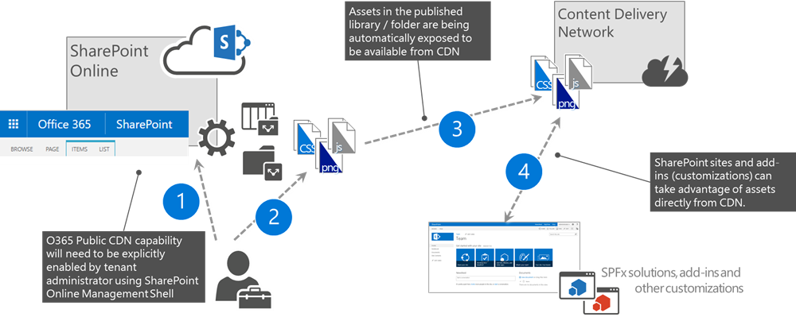
CDN: Public CDN Overview
Notes:
https://docs.microsoft.com/en-us/office365/enterprise/use-office-365-cdn-with-spo
https://www.youtube.com/channel/UC_mKdhw-V6CeCM7gTo_Iy7w/search?query=cdn

Slide 21
CDN: Public CDN overview (cont.)
Public CDN
For customer, public content:
Files that are not sensitive
For example: Logos, public pictures, JS, CSS.
Has fixed URL:
For example: https://publiccdn.sharepointonline.com/contoso.sharepoint.com/sites/testsite/Style%20Library/en-US/Themable/Core%20Styles/pagelayouts15.css
Notes:
https://docs.microsoft.com/en-us/office365/enterprise/use-office-365-cdn-with-spo
https://www.youtube.com/channel/UC_mKdhw-V6CeCM7gTo_Iy7w/search?query=cdn

Slide 22
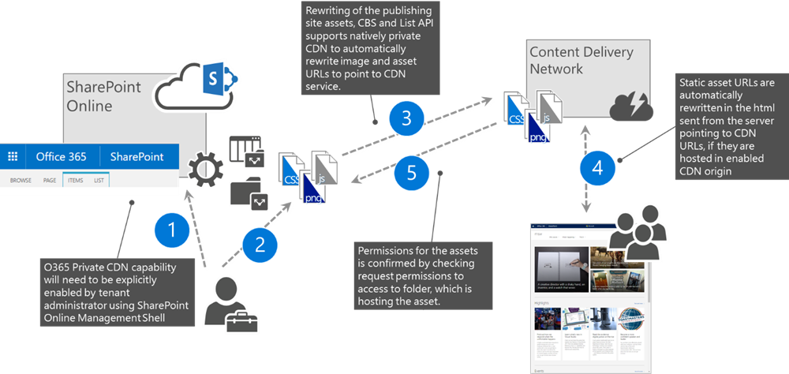
CDN: Private CDN Overview
Notes:
https://docs.microsoft.com/en-us/office365/enterprise/use-office-365-cdn-with-spo
https://www.youtube.com/channel/UC_mKdhw-V6CeCM7gTo_Iy7w/search?query=cdn

Slide 23
CDN: Private CDN Overview (cont.)
Private CDN:
~100ms slower than public.
Generated using the user’s cookie first to access a private content.
https://privatecdn.sharepointonline.com/contoso.sharepoint.com/sites/testsite/Style%20Library/en-US/Themable/Core%20Styles/pagelayouts15.css?_eat_=1550879189_d54f8df12b5f65bae705d55a0cf6ec24d4fc18f78442b213cc0d10daee149f8f&_oat_=1550879189_d4d5cb2fda7c5eba5dfd2185d9f6de44d350bb699a2dd1683f68647950da0a19
URL changes every 60 minutes (after creation).
Previous URLs are not accessible.
Notes:
https://docs.microsoft.com/en-us/office365/enterprise/use-office-365-cdn-with-spo
https://www.youtube.com/channel/UC_mKdhw-V6CeCM7gTo_Iy7w/search?query=cdn

Slide 24
CDN: Private CDN Overview (cont.)
Private CDN (continued from previous slide)
No standard authentication on the item, BUT…
Referrer check in place.
Simply copy-pasting the URL will give you “Invalid Referrer” error message.
One would need to know the exact URL where the object is used.
This assumes access to the original page.
Notes:
https://docs.microsoft.com/en-us/office365/enterprise/use-office-365-cdn-with-spo
https://www.youtube.com/channel/UC_mKdhw-V6CeCM7gTo_Iy7w/search?query=cdn

Slide 25
CDN: What goes to CDN?
Default locations:
Private
*/userphoto.aspx
*/siteassets
Public
*/masterpage
*/style library
*/clientsideassets (SPFx webparts utilize this for its files)
Default file types
CSS, EOT, GIF, ICO, JPEG, JPG, JS, MAP, PNG, SVG, TTF, WOFF
Cmdlet to get settings: Get-SpoTenantCdnPolicies –CdnType Public
Notes:
https://docs.microsoft.com/en-us/office365/enterprise/use-office-365-cdn-with-spo
https://www.youtube.com/channel/UC_mKdhw-V6CeCM7gTo_Iy7w/search?query=cdn

Slide 26
CDN: What goes to CDN? (cont.)
Custom locations:
Can be defined with the Add-SPOTenantCdnOrigin cmdlet.
Use wildcard wherever possible.
Custom file types:
Not available at this point.
Notes:
https://docs.microsoft.com/en-us/office365/enterprise/use-office-365-cdn-with-spo
https://www.youtube.com/channel/UC_mKdhw-V6CeCM7gTo_Iy7w/search?query=cdn

Slide 27
CDN: Public placeholder
Result: https://publiccdn.sharepointonline.com/test.sharepoint.com/siteassets/test.jpg
CDN URL subject to change in the future.
Above reference makes the solution future proof.
Search API does not use CDN yet, but search results can be changed to use the Public CDN.
Instead of | Use this
https://test.sharepoint.com/siteassets/test.jpg | Classic: window._spPageContextInfo.publicCdnBaseUrl + "/test.sharepoint.com/siteasssets/test.jpg"
 | Modern: this.context.legacyPageContext.publicCdnBaseUrl + "/test.sharepoint.com/siteasssets/test.jpg"
Notes:
https://docs.microsoft.com/en-us/office365/enterprise/use-office-365-cdn-with-spo
https://www.youtube.com/channel/UC_mKdhw-V6CeCM7gTo_Iy7w/search?query=cdn

Slide 28
CDN: Private placeholder
No placeholder is required.
The SPO WFE servers will put the correct URL into the ASPX page.
Remember, the URL is changing every 60 minutes.
Notes:
https://docs.microsoft.com/en-us/office365/enterprise/use-office-365-cdn-with-spo
https://www.youtube.com/channel/UC_mKdhw-V6CeCM7gTo_Iy7w/search?query=cdn

Slide 29
CDN: Command Set
Get-Command *TenantCdn*
Set-SPOTenantCdnEnabled -Enable $true -CdnType <Both, Private, Public> (without any params will configure all default settings including both public and private and default origins) If you don’t’ want the default origins, you can add the -NoDefaultOrigins switch.
Get-SPOTenantCdnEnabled
Add-SPOTenantCdnOrigin Example: Add-SPOTenantCdnOrigin -CdnType Public -OriginUrl "*/masterpage“
Get-SPOTenantCdnOrigins
Remove-SPOTenantCdnOrigin
Get-SPOTenantCdnPolicies
Set-SPOTenantCdnPolicy
Notes:
https://docs.microsoft.com/en-us/office365/enterprise/use-office-365-cdn-with-spo
https://www.youtube.com/channel/UC_mKdhw-V6CeCM7gTo_Iy7w/search?query=cdn

Slide 30
Navigation: Structured Navigation
NOT a recommended navigation option in SPO.
Designed for an on-premises topology:
has limited support in SharePoint Online.
One of the most common root causes for page slowness.
Cannot be fixed from code due to how it is designed:
Reduce the site's complexity.
Implement a different navigation solution.
Notes:
Notes:
Structured Navigation, like all of the Publishing Features, was built for an On-Premises deployment. The feature depends heavily on the Object Cache, which is a small, in-memory cache for objects such as Lists and Webs. It is highly efficient to serve requests from this cache, but incredibly expensive to cache new objects.
This caching is important to understand in this context, because Structured Navigation is built to iterate over a site collection to find pages and webs and display these items dynamically on the navigation controls. This iterative approach is incredibly expensive, even more so without the Object Cache, as it must be performed for every request. The costs of iteration are further increased as the structure grows more complex, and unique permissions are implemented.
There is no fix for Structured Navigation. The only options are to reduce the site's complexity, or to implement a different navigation solution.

Slide 31
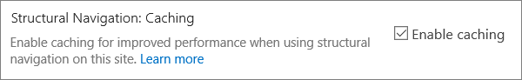
Navigation: Structured Navigation Caching
If you have to use Structured Navigation use Caching.
See: Structural navigation and performance
Note!
Not a silver bullet!
Helps
Caching must be refreshed to have immediate effect
Otherwise 24 hours cache period
Notes:
Structural navigation and performance: https://support.office.com/en-us/article/structural-navigation-and-performance-f163053f-8eca-4b9c-b973-36b395093b43

Slide 32
Navigation: Security trimming
A function that checks authorization on navigation links.
Kicks in on page load.
Applies to all navigation elements.
The delay is exponential to the size of the site structure under the root.
Can be turned off under Site Settings/Site collection navigation.

Slide 33
Navigation: Alternatives to Structured Navigation
Managed Navigation
Search-driven Navigation
Custom Navigation Provider

Slide 34
Navigation: Managed Navigation
Built on Managed Metadata Term Sets to display navigation.
New pages create new associated term.
Friendly URL is configured also.
Available for both:
Global and Current navigation
Classic and Modern UI
Notes:
https://docs.microsoft.com/en-us/sharepoint/administration/overview-of-managed-navigation

Slide 35
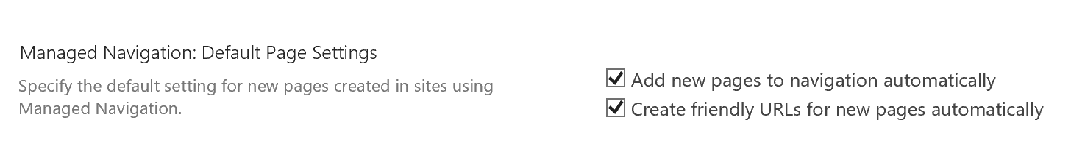
Navigation: Managed Navigation (cont.)
To optimize Metadata Navigation performance, turn off:
Add new pages to navigation automatically .
Create friendly URLs for new pages automatically.
Security trimming.
Notes:
https://docs.microsoft.com/en-us/sharepoint/administration/overview-of-managed-navigation

Slide 36

Navigation: Search driven navigation
Aka.: Metadata Navigation
Not the same as Managed Navigation:
Classic UI feature only.
Adds refinement capabilities to lists and libraries.
Has a negative impact on publishing page performance.
Additional SQL RTs are required for each page request.
Enabled by the Metadata Navigation and Filtering site feature.
Notes:
https://support.office.com/en-us/article/Set-up-metadata-navigation-for-a-list-or-library-C222A75D-8B18-44E2-9ED8-7EE4E0D23CFC

Slide 37
Navigation: Option comparison
 | Managed navigation ✓ | Structural navigation ✗ | Search-driven navigation ✓ | Custom navigation provider 
PROs | Easy to maintain Recommended option | Easy to configure Security trimmed Automatically updates as content is added. | Security trimmed Automatically updates as sites are added. Fast loading time Locally cached navigation structure. | Wider choice of options available. Fast loading when caching is used correctly. Many options work well with responsive page design.
CONs | Not automatically updated to reflect site structure. Impacts performance if security trimming is enabled. | Not recommended Impacts performance and scalability. Subject to throttling | No ability to easily order sites. Requires customization of the master page (technical skills required). | Custom development is required. External data source/cache stored is needed for example, Azure.

Slide 38
Navigation: Long term solution
Use Hub Sites
Available for Modern sites
Connect site collections for navigation (and branding)
Eliminates much of the overhead on navigation
less subsites for the navigation to load
Notes:
https://docs.microsoft.com/en-us/sharepoint/planning-hub-sites

Slide 39
Permissions: How they affect performance?
SharePoint uses security trimming everywhere:
Standard UI (example: document libraries, lists, etc.).
Search
Navigation
Fine-grained permissions cause performance issues:
Multiple INNER-JOIN queries in SQL.
Exponential execution time.

Slide 40
Permission: How to optimize permissions?
Use permission inheritance
Use Sharing Links
They create unbreakable security descriptors!
Restructure data if permission inheritance is not applicable
Break permission on the highest level possible
Grant “Manage Permissions” permission to Owners only
Remember the dependencies with Groups connected sites.
Notes:
Sharing Links (sharing through links) creates unique permission set that is not breakable. They also override broken permissions in a document library. Ex.: If you have a document library with broken permissions on many levels, the security descriptor created through Sharing Link will override the permission break and grant access to the items (and all future items) in the structure below.

Slide 41
Browser: What to use with SPO?
Modern Browsers should be the primary browsers to use which include:
Microsoft Edge
Chrome
FireFox
Safari*
Internet Explorer is not the recommended browser

Slide 42
Browser: Why use Microsoft Edge/Chrome over IE11?
Huge architectural differences between the browsers, including:
network traffic handling.
content interpretation, and rendering.
memory management, and garbage collection.
New features and improvements developed for Microsoft Edge:
Issues reproduced on Microsoft Edge have higher chance to be fixed.
Notes:
In terms of why this appears to be a performance difference in IE vs. Chrome is because, IE calculates the exact size of the elements before rendering (which appears to the user as a decrease in performance with large content) to make sure the content is rendered correctly. Whereas, in Chrome or Firefox, a different algorithm is used to render the content progressively before it has all been passed.
In the case of progressive rendering content, it can result in an experience where content is initially displayed and then moved as the browser progresses creating a clunky and poor-quality feel.

Slide 43
Page load optimization: Modernization Scanner
Scan your classic sites for modernization options:
Optimize the use of modern list and libraries.
Connect these sites to an Office 365 group.
Modernize the wiki and web part pages by creating modern site pages.
Rebuild classic publishing portals with modern publishing portals.

Slide 44
Page load optimization: Lighter customizations
Use Modern pages:
Modern DocLib view is not a modern page.
Modern sites or modern pages are required.
Navigation:
Don’t use Structural Navigation.
Use Metadata Navigation.

Slide 45
Page load optimization: Lighter customizations
Use modern webpart:
Content Rollup instead of Content Query.
Write your own SPFx web part if you need something more customized.
JS and CSS optimization:
Minification
Obfuscation (only for JS).

Slide 46
Page load optimization: Lighter customizations
CSOM/REST call optimization:
Use Async wherever possible.
Use Batching.
Use client-side caching:
Use Azure Cache.
Recommended caching interval 15 minutes.
Use local cache (PNP usingCaching method).
Notes:
https://docs.microsoft.com/en-us/previous-versions/msp-n-p/ff798420(v=pandp.10)

Slide 47
Page load optimization: Lighter customizations
XHR request minimization:
Ex. Request Digest
Header:
Accept: application/json; odata=nometadata
Notes:
https://en.wikipedia.org/wiki/XMLHttpRequest

Slide 48
Page load optimization: Use the O365 portfolio
Forms for Survey.
PowerApps for business logic forms .
Flow for automation.
Stream for media content.
Azure services instead of complex SharePoint add-on.
Etc.
See the related SharePoint Ignite 2019 session: THR1017.
Notes:
THR1017 - Stop doing these four things in SharePoint and start doing them in Azure https://myignite.techcommunity.microsoft.com/sessions/79164?source=sessions

Slide 49
Page load optimization: Rules 101
Prefer Modern SPO Pages and Sites | Prefer OOB when possible
Continuous monitoring and innovation. Investment for reliability, scalability, performance. | Reduce Time to Market. (Publishing features are not recommended in the Cloud).
Measure page weight and request | Use CDN
Large downloads waste time: Optimize images for screen. Multiple roundtrips cause slowness: Page load is as slow as the slowest request. | Optimize download times of static content.
Notes:
Best practices for optimizing performance of SharePoint sites and portals in Microsoft 365 https://myignite.techcommunity.microsoft.com/sessions/81512?source=sessions

Slide 50
Page load optimization: Rules 101 (cont.)
Defer download content | Use Last Known Good (LKG) pattern
Don’t download things that are not visible. Example: Submenu items Page 2 of news View counts Social decorations | Persist what the user saw earlier. Refresh after critical page rendering. Define animation when new content arrives. SPFx webparts support LKG.
Avoid monolithic design | Limit tenant-wide services
Large site collections Hierarchy that is hard to scale and reorganize. | User Profile and Taxonomy Can use caching SPFx webparts with LKG are handy here.
Notes:
Best practices for optimizing performance of SharePoint sites and portals in Microsoft 365 https://myignite.techcommunity.microsoft.com/sessions/81512?source=sessions

Slide 51
Page load optimization: Rules 101 (cont.)
Do not use CQWP | Avoid iFrame
Cross-list queries do not scale. Use Content by Search instead. | iFrames are expensive. Potential duplicate load of dependencies. Don’t work well with mobile. Put it below the fold so that it would not render at first view.
Beware jank | Don’t do load test
Rendering content that shifts. Avoid redraw, flash. Declare height and width. Load web font upfront. | Might be throttled. More about this later.
Notes:
Best practices for optimizing performance of SharePoint sites and portals in Microsoft 365 https://myignite.techcommunity.microsoft.com/sessions/81512?source=sessions

Slide 52
Page Load Optimization: Words of wisdom
None of the above recommendations are new.
Was not enforced (We’re getting there).
Suboptimal pages can cause intermittent performance issues based on general usage.
Think about a highway, traffic jams can be caused by construction, but also by the drivers on the road…

Slide 53
What are the main performance issue generators?
Classic pages, structured navigation, complex permission structure.
How can you make the page load lighter?
Use modern webparts, JSS/CSS optimization, CSOM/REST optimization, client-side caching.
What alternatives you have for Structured Navigation?
Managed Navigation, Search-driven Navigation, Custom navigation provider

Slide 54
There are optimization options on all levels.
Classic pages, Structured navigation and permissions are the primary performance issue generators.

Slide 55

Questions?
Notes:
Do not answer these yet. Bring these up now so that the students can think about their answers after we run through the rest of the modules.

